Slide 1
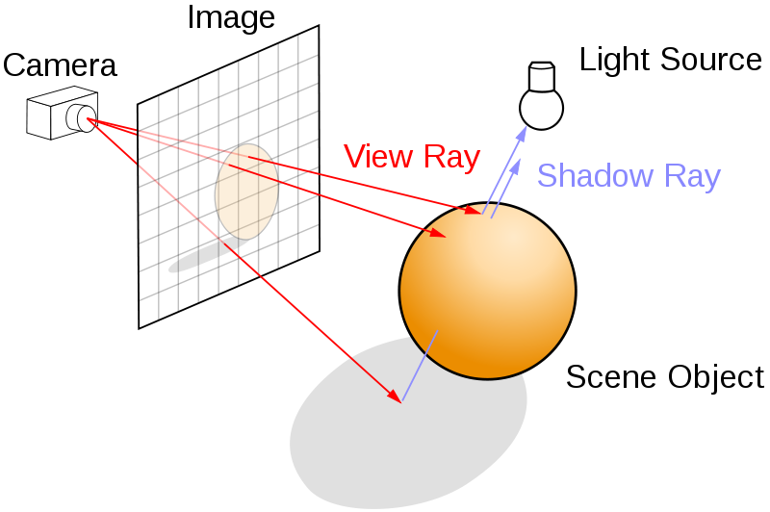
RAY TRACING
SIDHARTH YADAV : 374/CO/15
SWARAJ KUMAR : 381/CO/15

Slide 2
What is Ray Tracing?
In computer graphics, ray tracing is a rendering technique for generating an image by tracing the path of light as pixels in an image plane and simulating the effects of its encounters with virtual objects.
It is based on the idea that you can model reflection and refraction by recursively following the path that light takes as it bounces through an environment.
Ray tracing is capable of simulating a wide variety of optical effects, such as reflection and refraction, scattering, and dispersion phenomena

Slide 3
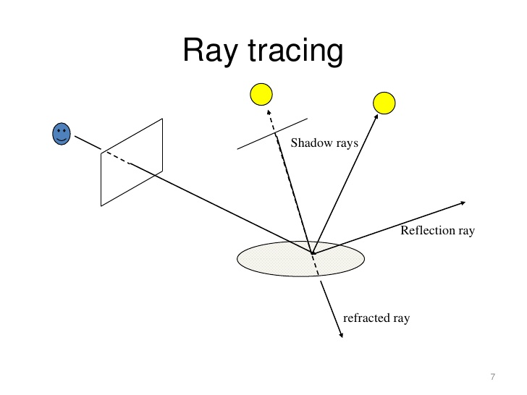
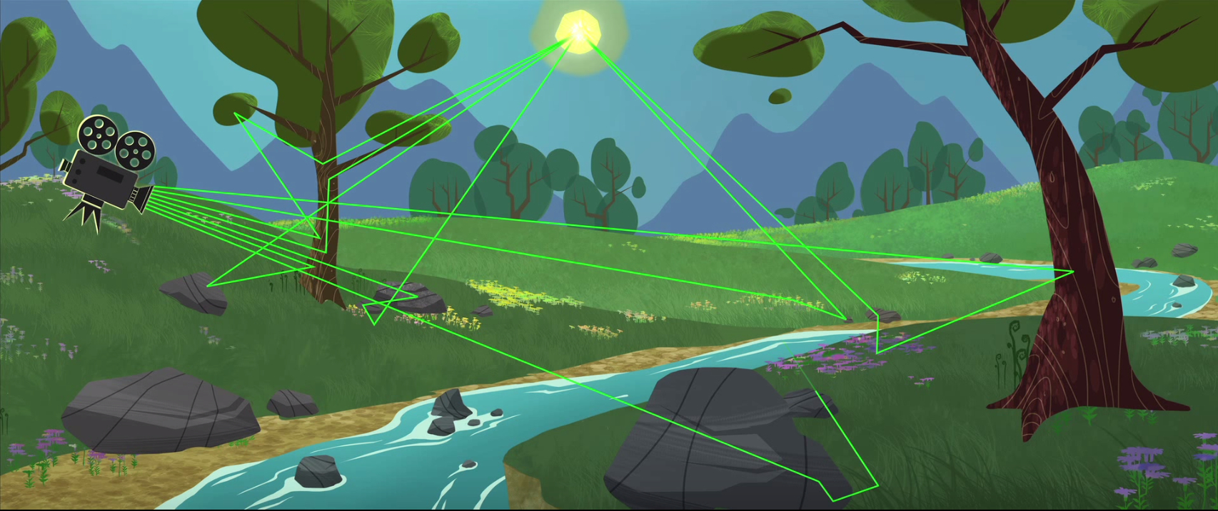
Ray Tracing : Intuition
Different Rays used
Video depicting working principle of Ray Tracing
Make sure video is in the same file as the PPT

Slide 4
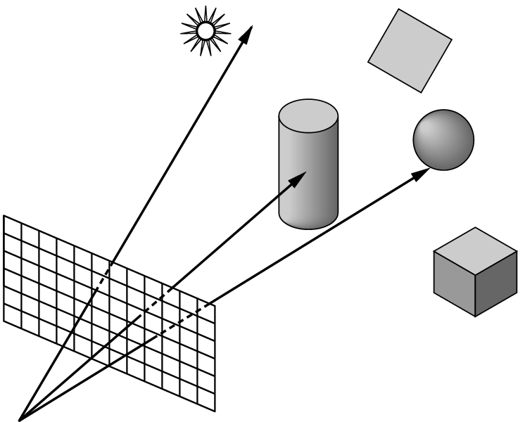
Backward Ray Tracing
Ray-casting: one ray from center of projection through each pixel in image plane
Illumination
Phong (local as before)
Shadow rays
Specular reflection
Specular transmission
(3) and (4) are recursive

Slide 5
History
The first implementation of a "real-time" ray-tracer was the LINKS-1 Computer Graphics System built in 1982 at Osaka University's School of Engineering, by professors Ohmura Kouichi, Shirakawa Isao and Kawata Toru.
The LINKS-1 system was developed to realize an image rendering methodology in which each pixel could be parallel processed independently using ray tracing. By developing a new software methodology specifically for high-speed image rendering, LINKS-1 was able to rapidly render highly realistic images.
It was used to create the world's first 3D planetarium-like video of the entire heavens that was made completely with computer graphics.

Slide 6
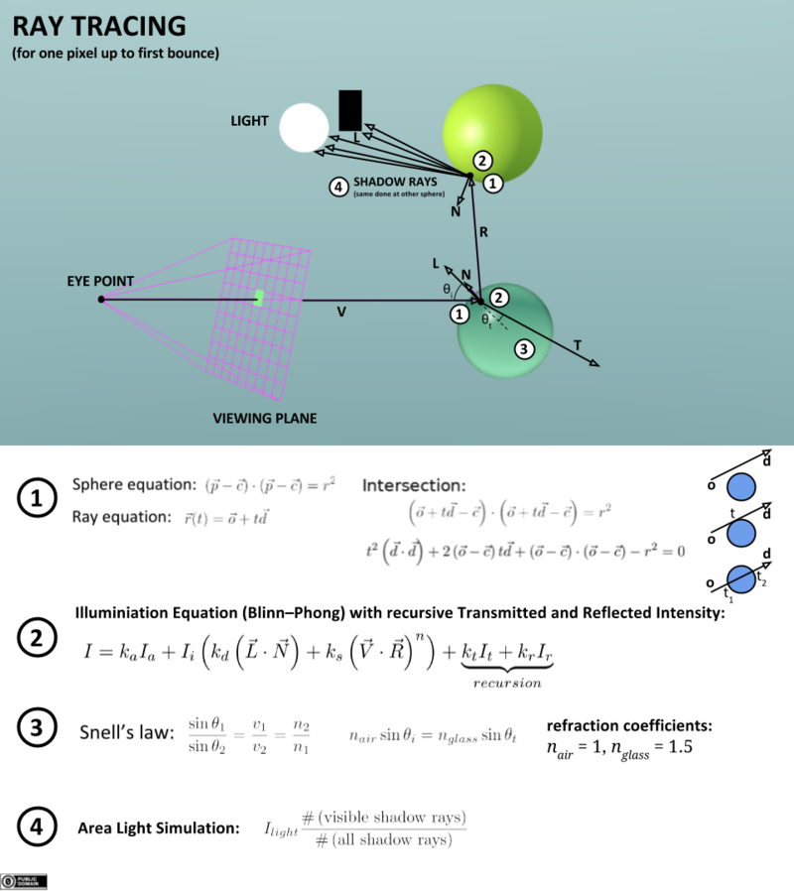
Ray Tracing Algorithmic Description
Builds the image pixel by pixel.
Cast additional rays from the hit point to determine the pixel color-
Shoot rays toward each light. If they hit something, the object is shadowed from that light, otherwise use “standard model” for the light .
Reflection rays for mirror surfaces, to see what should be reflected in the mirror.
Refraction rays to see what can be seen through transparent objects
Sum all the contributions to get the pixel color.

Slide 7
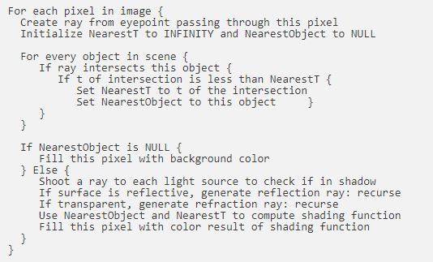
Algorithm: Classical Recursive Ray Tracing

Slide 8


Running Code and Output
Please click on the icons to run .exe files
Portable Pixmap Format (PPM) file
Output
Please install the dependencies listed in the Readme

Slide 9
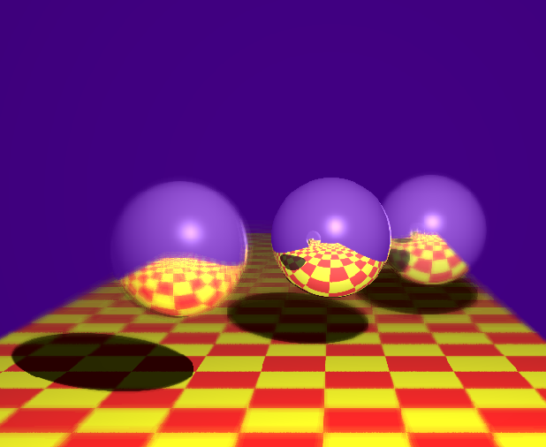
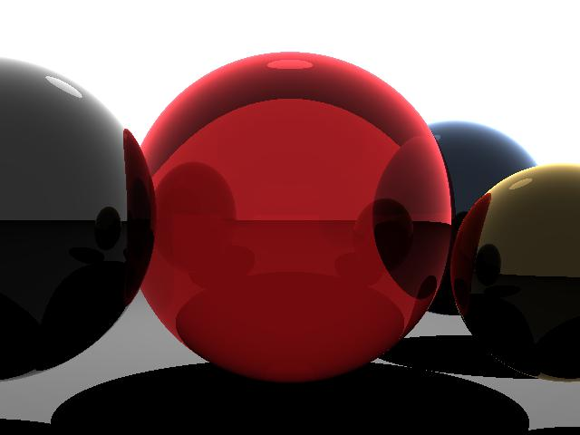
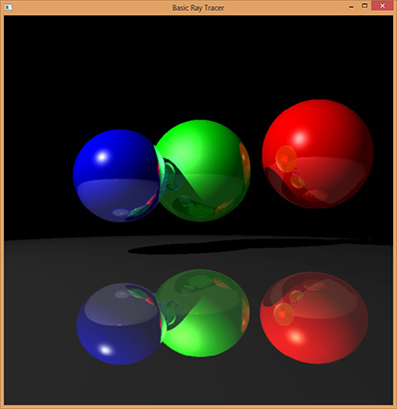
Sample Outputs

Slide 10
Advantages
Ray tracing's popularity stems from its basis in a realistic simulation of lighting over other rendering methods (such as scanline rendering or ray casting).
Effects such as reflections and shadows, which are difficult to simulate using other algorithms, are a natural result of the ray tracing algorithm.
Relatively simple to implement yet yielding impressive visual results, ray tracing often represents a first foray into graphics programming.
A simple version of ray tracing known as ray transfer matrix analysis is often used in the design of optical resonators used in lasers.

Slide 11
Disadvantages
1) A serious disadvantage of ray tracing is performance. Scanline algorithms and other algorithms use data coherence to share computations between pixels, while ray tracing normally starts the process anew, treating each eye ray separately. However, this separation offers other advantages, such as the ability to shoot more rays as needed to perform anti-aliasing and improve image quality where needed.it is nice thing.
2) If running on a complex environments, then GPUs (Graphical Processing Units) are needed for effective implementation of ray tracing.

Slide 12
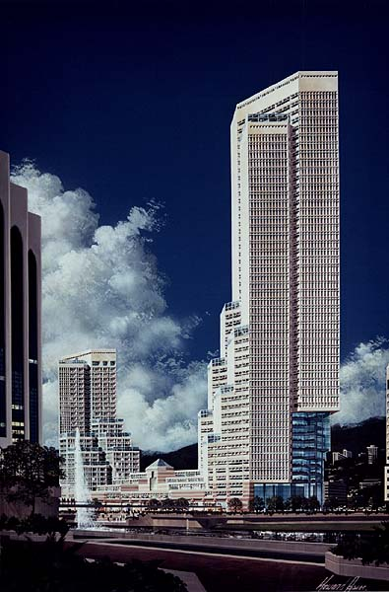
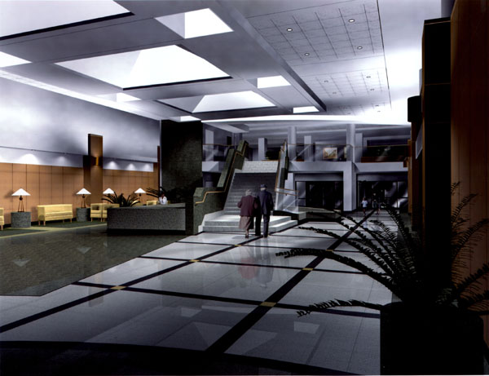
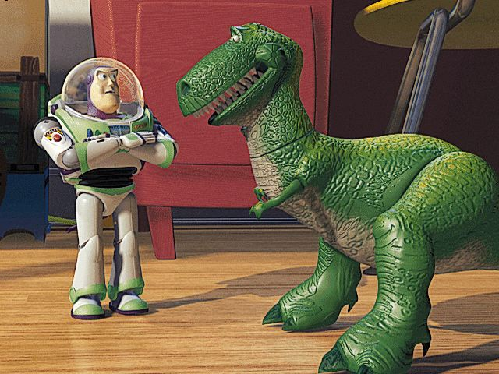
Applications
Architecture
Lighting Design
Animation

Slide 13
THANK YOU

